Slide 1
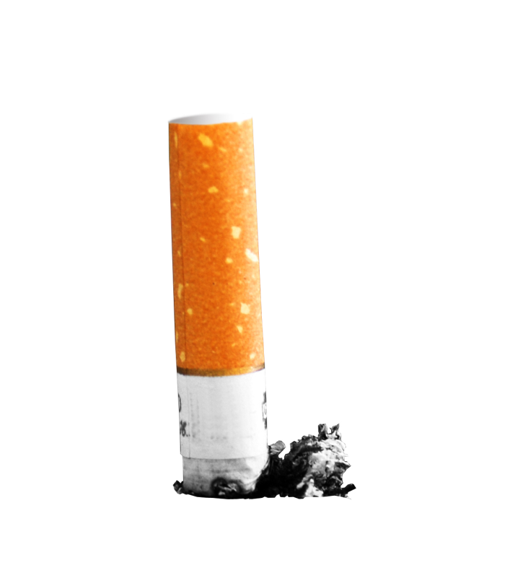
TOBACCO
Don’t be a Butthead

Slide 2
Review-Take out a sheet of paper!
What is the main addictive chemical in tobacco?
What kind of drug is it?
Name 5 different effects tobacco has on your body?
What types of diseases can you get from using nicotine products?
Think back to your speakers; what was one thing that stuck out to you the most from their presentation?

Slide 3
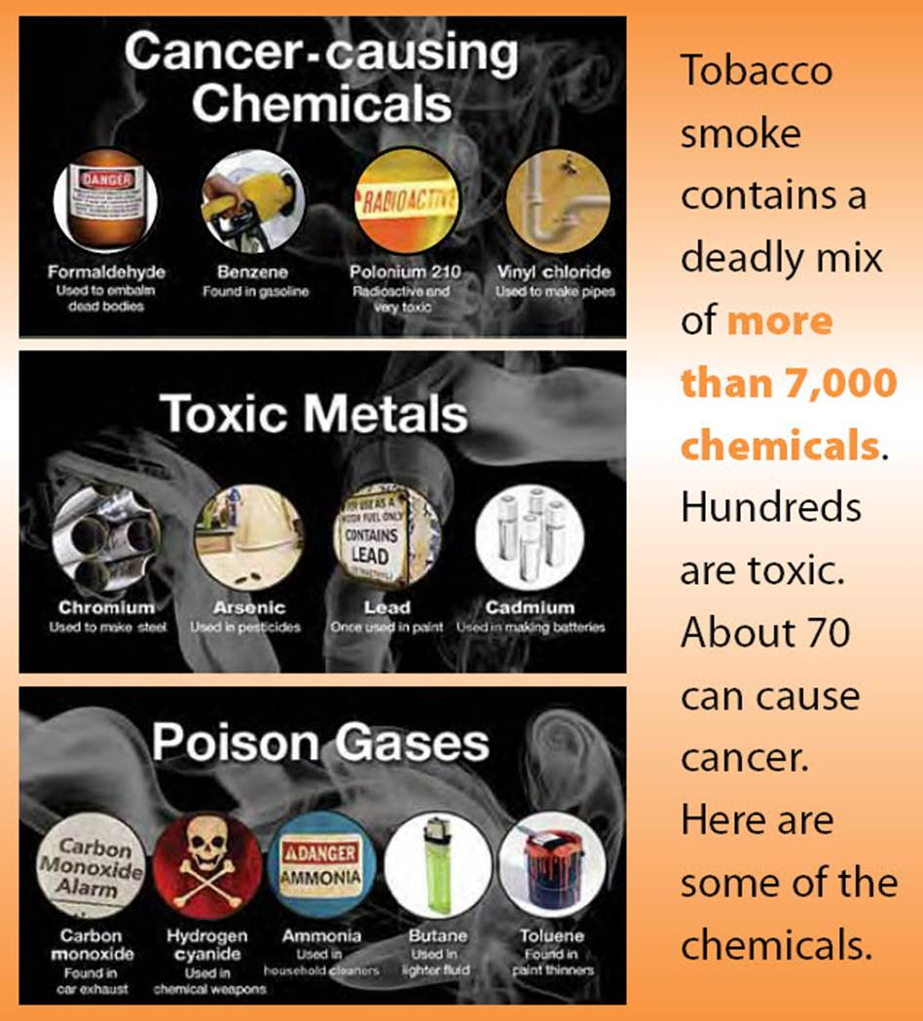
Cigarettes
According to the CDC…2011
carcinogens - cancer causing agents*
Tar- is the main carcinogen, cancer causing agent in tobacco. *

Slide 4
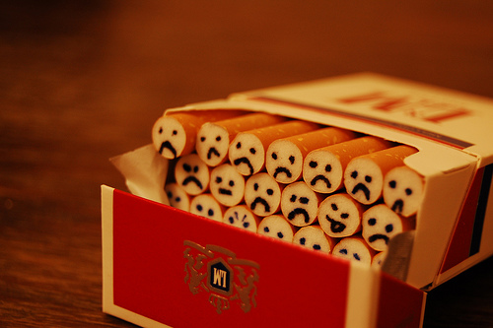
Tobacco
Contains NICOTINE -- the addictive drug in tobacco; triggers the release of stress hormones.
Nicotine is classified as a Stimulant -- a drug that increases the action of the CNS, the heart, and other organs.
Tobacco contains 69 known carcinogens.*
Tobacco has the highest amount of individuals that die every day in the U.S.
Tobacco companies “Big Tobacco” targets today’s youth to make up for tobacco related deaths (all about the $). *

Slide 5
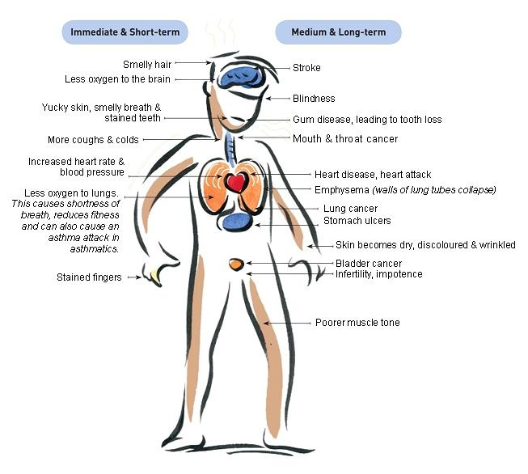
Short Term Effects of Smoking on Body
Mouth -- bad breath, yellow teeth
Senses – dulls the ability to smell & taste normally*
Lungs – reduces lung capacity; efficiency of lungs decrease.
Reduces stamina*
Shortness of breath
Fingers -- yellow stains and fingers smell.
Wrinkles skin

Slide 6
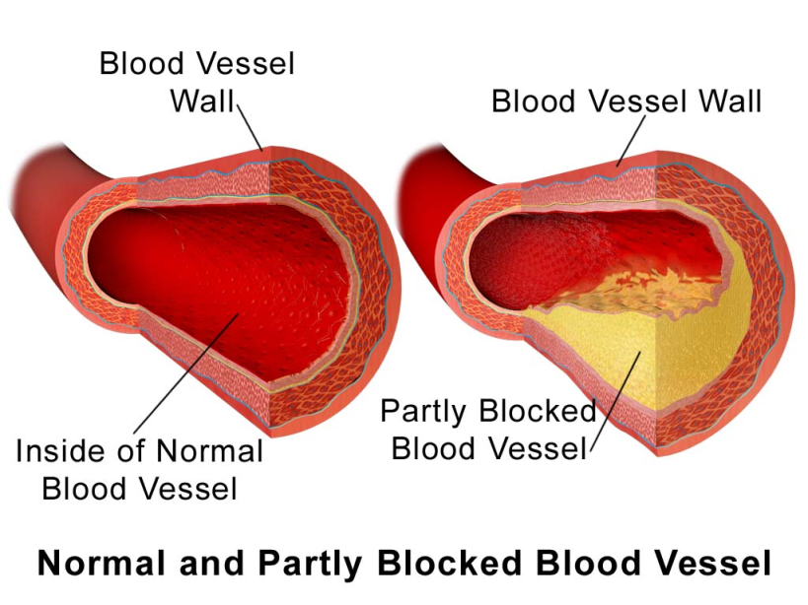
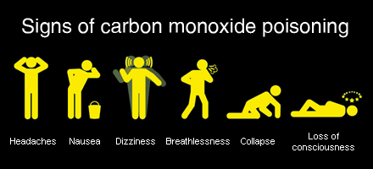
Effects (cont.)
Cardiovascular -- Nicotine causes blood vessels to constrict, forcing the heart to pump faster and increase blood pressure. Greater chance of stroke and cardiovascular disease.
WARNING- This is really gross
Carbon Monoxide -- poisonous gas when tobacco burns that cause oxygen transportation to be less efficient.

Slide 7
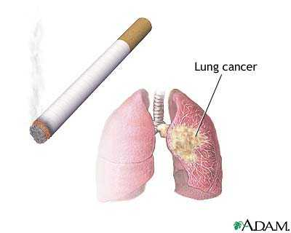
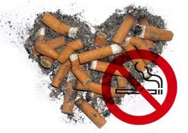
Leading causes of death from Cigarettes
Cancer
  #1 cause of lung cancer
  Accounts for 80% of all lung cancer deaths.*
  Smoker's lung Vine
Heart disease
  Smoking accounts for 1/3 of all deaths.
  Heart disease is the United States #1 killer.

Slide 8
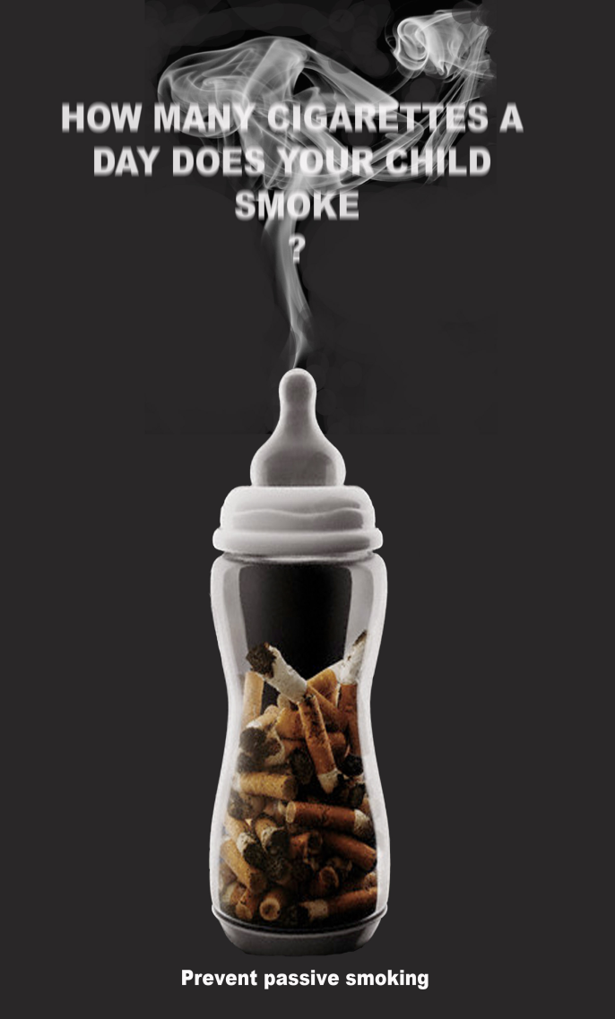
Passive Smoking
Mainstream -- The smoke that is exhaled by the smoker.
Sidestream Smoke -- smoke that enters the air from the burning tip of the cigarette. (Worst kind)
“Second hand” Smoke--made up of side stream smoke and exhaled mainstream smoke, mixed with the surrounding air.
"Third-hand“ or “Passive” Smoke --cigarette byproducts that cling to smokers' hair and clothing as well as to household fabrics, carpets and surfaces — even after secondhand smoke has cleared. Involuntarily inhaling

Slide 9
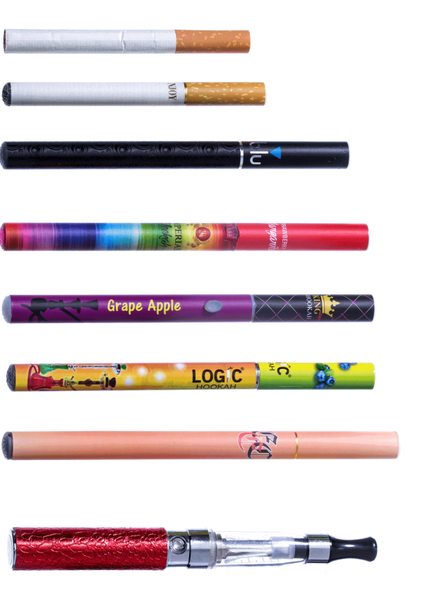
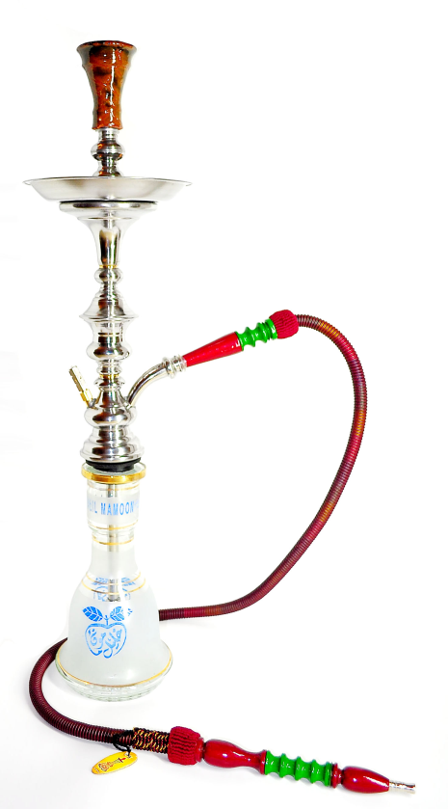
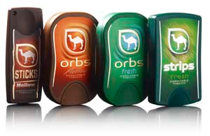
Other Tobacco Products
Think back to the Nicotine Awareness presentation…
What other tobacco/nicotine products did they talk about? What are their risks?

Slide 10
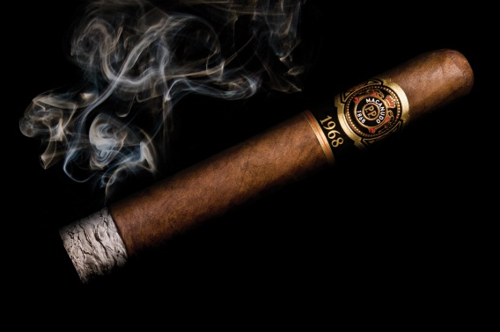
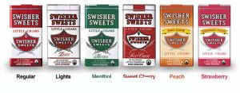
Cigars and Cigarillos
  Cigar smokers have the same chance of smoking related illnesses as cigarette smokers. They actually have increased risk of mouth/oral cancers.
  One cigar = smoking 5 cigarettes
  If you are breathing- you are inhaling!

Slide 11
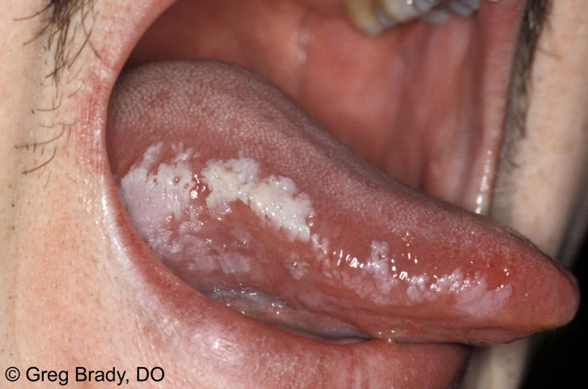
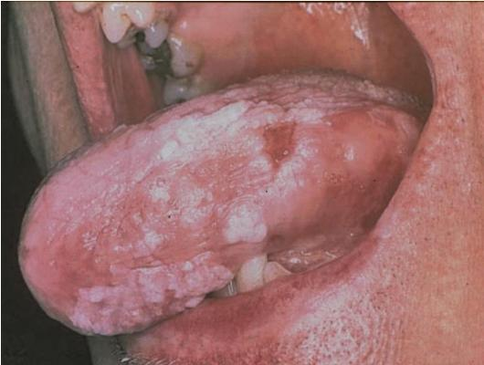
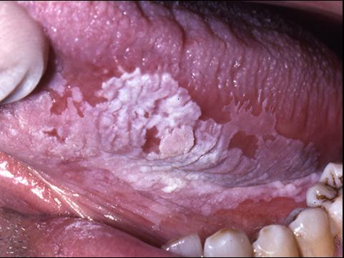
Smokeless Tobacco
What are some smokeless tobacco products?
Greater risk of mouth or lung cancer than smoking.
Leukoplakia -- thickened, white, leathery appearing spots inside mouth.
  Tongue, cheeks, gums, throat
Can develop into cancer. *On the Test!!*

Slide 12
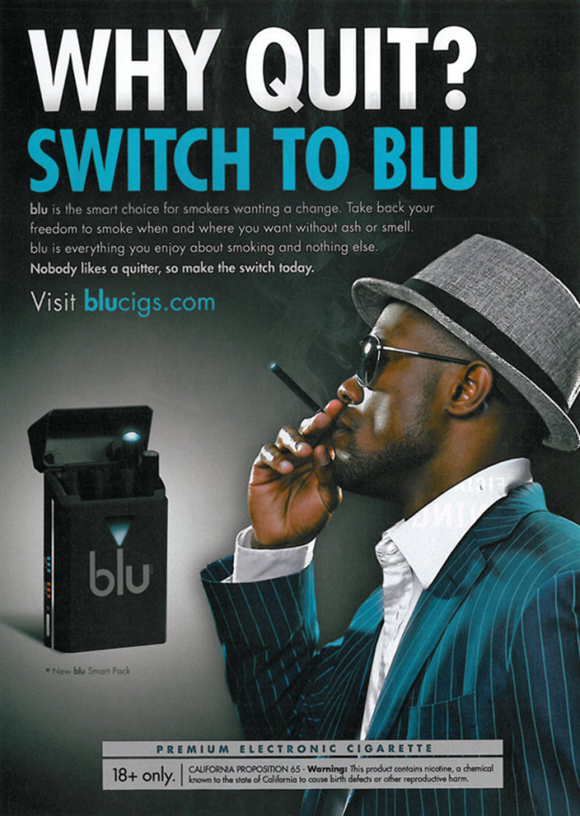
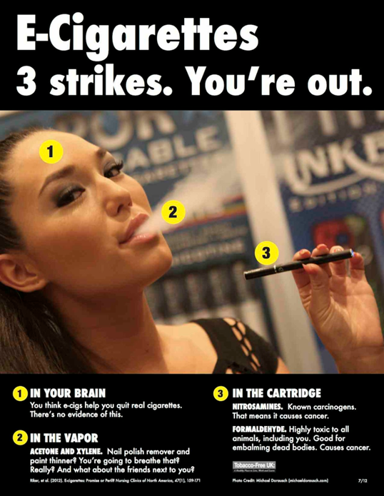
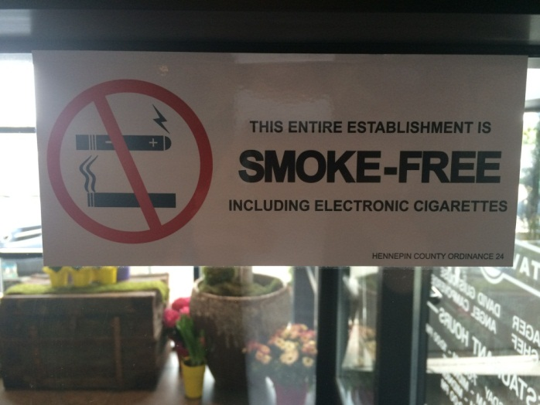
E-Cigs
Can be “nicotine free” and STILL contain nicotine!!
Are NOT just water and nicotine!
Switching to e-cigs is NOT a healthy choice.

Slide 13
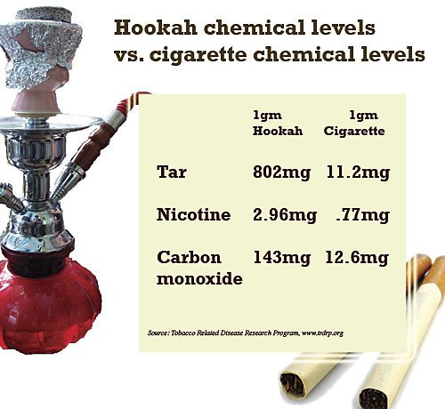
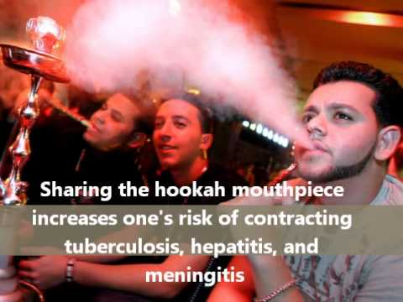
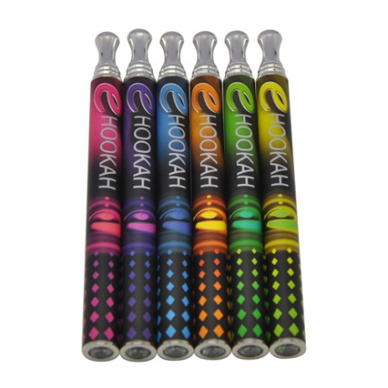
Hookahs
E-hookahs

Slide 14
Review-Answers
Nicotine
Stimulant-speed you up!
3. Mouth -- bad breath, yellow teeth, Senses – dulls the ability to smell & taste normally*, Lungs – reduces lung capacity; efficiency of lungs decrease. Reduces stamina* Shortness of breath Fingers -- yellow stains and fingers smell,Wrinkles skin
4. What types of diseases can you get from using nicotine products? Cirrhosis-liver, heart disease-heart, cancer-, COPD,
5. Cool info from speaker?

Slide 15
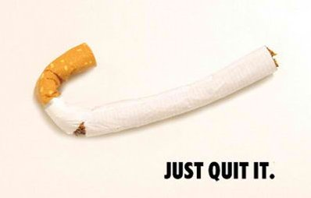
Quitting & Ways to Start
  Remind yourself of the benefits
  Find ways to replace tobacco
    Gum, suckers, toothpicks, nicotine patches, etc.
  Seek Support
    SmokefreeTXT
    QuitStartAPP
    LiveHelpChat
  Quit Smoking Timeline
  It takes 10 years after quitting for a smoker’s risks of lung cancer to be the same as a non smoker
What are some of the benefits of quitting?

